Slide 1
Precipitation Reactions
Lucarelli CHAPTER 16

Slide 2
Ionic Compounds – Write Formulae
1. Barium fluoride
2. Calcium hydroxide
3. Chromium (III) oxide
4. Lithium sulphate
5. Silver phosphate
6. Potassium nitrate
7. Iron (II) iodide
8. Tin (II) sulphide
9. Gold (III) carbonate
10. Lithium carbonate

Slide 3
Ionic Compounds
**
6. Potassium nitrate KNO₃
7. Iron (II) iodide FeI₂
8. Tin (II) sulphide SnS
9. Gold (III) carbonate Au₂(CO₃)₃
10. Lithium carbonate Li₂CO₃
1. Barium fluoride BaF₂
2. Calcium hydroxide Ca(OH)₂
3. Chromium (III) oxide Cr₂O₃
4. Lithium sulphate Li₂SO₄
5. Silver phosphate Ag₃PO₄

Slide 4
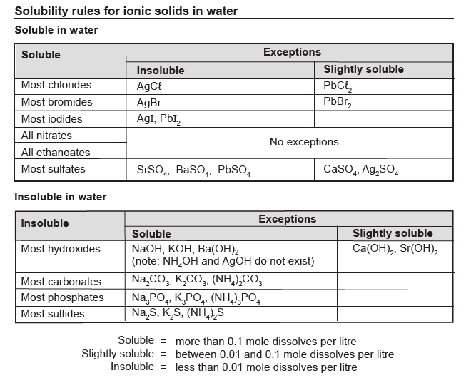

Slide 5
Review
Soluble or insoluble?
Ba(NO₃)₂
PbI₂
Ba(OH)₂
SrSO₄
FePO₄

Slide 6
Review – Double Displacement
K₃PO₄ + AgNO₃ →
FeI₂ + Ba(OH)₂ →
******************
NaCl + CaSO₄ →

Slide 7
Review
Write balanced chemical equations:
Cr₂S₃ _{(aq)} + Na₃PO₄ _{(aq)} →
Na₂SO₄ _{(aq)} + SnCO₃ _{(aq)} →
Iron (III) chloride + silver nitrate →

Slide 8
Net Ionic Equations
Balanced molecular equation
Identify phase symbols
Total ionic equation
Net ionic equation (remove spectator ions)
E.g. silver nitrate (aq) + potassium chloride (aq) →
silver chloride (s) + potassium nitrate (aq)

Slide 9
Net Ionic Equations
Balanced molecular equation
Identify phase symbols
Total ionic equation
Net ionic equation (remove spectator ions)
3 Mg(NO₃)₂ _{(aq)} + 2 Na₃PO₄ _{(aq)} → Mg₃(PO₄)₂ _{(s)} + 6 NaNO_{3 (aq)}

Slide 10
Net Ionic Equations
Balanced molecular equation
Identify phase symbols
Total ionic equation
Net ionic equation (remove spectator ions)
Lucarelli, page 47, Questions 6 and 7 – Net Ionic Equations
Net ionic equations worksheet – Using the Solubility Table
Lucarelli, Set 27, Page 143

Slide 11
Final Review
Johnny noticed a white solid that had built up on the inside of his kettle. His chemistry teacher told him that it is due to the precipitation of CaCO₃ from Ca²⁺ and CO₃²⁻ ions present in tap water.
Write the net ionic equation with state symbols.
SO₄²⁻ ions are also present. Will Ca²⁺ react with SO₄²⁻ ? Why?

Slide 12
Net Ionic Equations
Balanced molecular equation
Identify phase symbols
Total ionic equation
Net ionic equation (remove spectator ions)
3 Mg(NO₃)₂ _{(aq)} + 2 Na₃PO₄ _{(aq)} → Mg₃(PO₄)₂ _{(s)} + 6 NaNO_{3 (aq)}

Slide 13
Chemical Bonding
Pearson Chapter 4-6
Lucarelli Chapter 8
STAWA Set 14-18
Covalent Networks
Pearson Chapter 7
Lucarelli Chapter 8.8-8.9
IMFs
Pearson Chapter 12
Lucarelli Chapter 15
STAWA Set 19-20
Calculations and Formulae
Pearson Chapter 5
Lucarelli Chapter 4
STAWA Set 25
Chromatography
Pearson Chapter 13
Lucarelli Chapter 3
STAWA Set 4
Solutions
Pearson Chapter 15-16
Lucarelli Chapter 6
STAWA Set 27-28

